Slide 1

Satellite data products to support climate modelling: Phenology & Snow Cover
Kristin Böttcher, Sari Metsämäki, Olli-Pekka Mattila, Mikko Kervinen, Mika Aurela, Saku Anttila

Slide 2
Content
Introduction & objectives
Satellite time-series
  Vegetation indices
  Snow cover
Extraction of start of season from satellite time-series
  In situ data
  Comparison of satellite-derived indicators with in situ dates
  Maps for the start of season in Finland
  Summary & Outlook

Slide 3
Introduction & objectives
Sparse observation network for validation of model results
Need to generalize information provided by in situ sites
Provide time-series of vegetation indices and snow cover for the evaluation of the performance of JSBACH model in the spatial domain
Assessment of snow-related variables of JSBACH: comparison of model output and remote sensing data
Definition of proxy indicators for ecosystem functioning (e.g. start of growing season) from remote sensing data

Slide 4
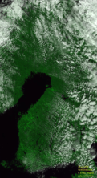
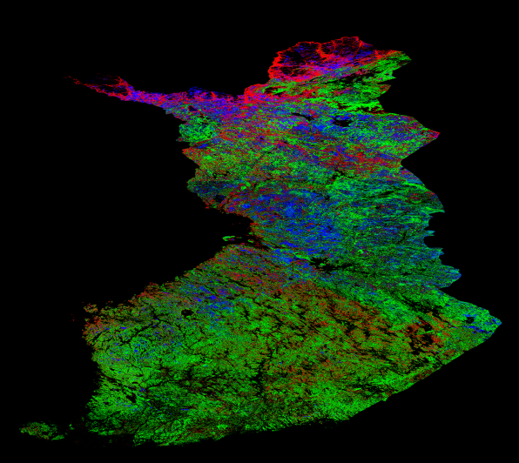
Satellite time-series
Daily time-series of satellite-indices derived from Terra/ Moderate Resolution Imaging Spectrometer (MODIS) 2001-2010
  Normalized Difference Vegetation Index (NDVI), 250 m
  Normalized Difference Water Index (NDWI), 500 m
  Snow Covered Area (SCA), 500 m
Sat.
Data
Pre-processing,
Cloud masking
Snow cover and vegetation estimates
Pixel-based land use information
Time-series for different years
Extraction of time-series
Fraction of coniferous forest (green),
broadleaf deciduous forest (red), open bogs (blue)

Slide 5
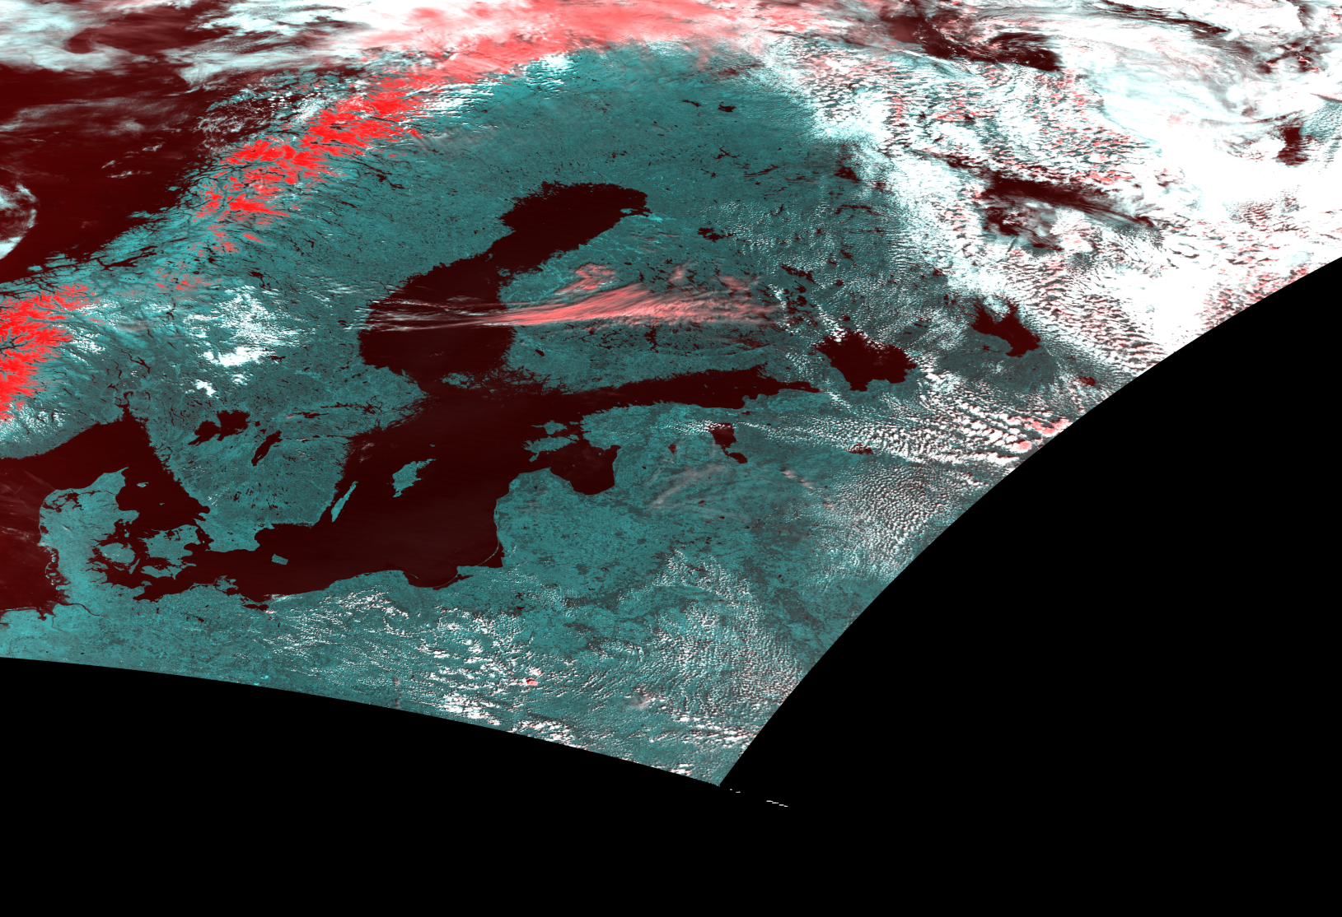
NDVI-Product (left) and NDWI-Product (right)
2007-06-08
Notes:
NDVI 20070608

Slide 6
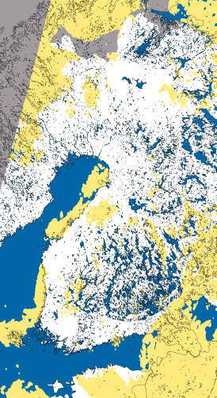
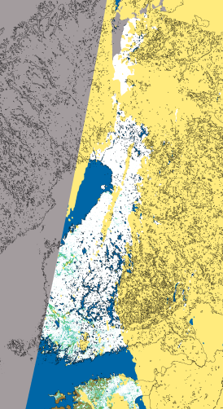
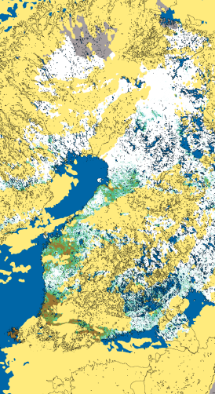
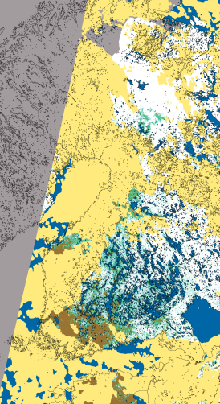
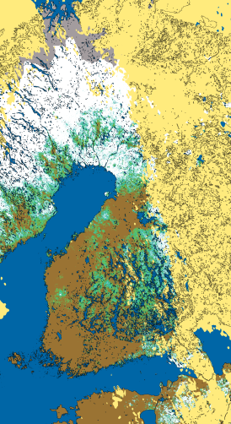
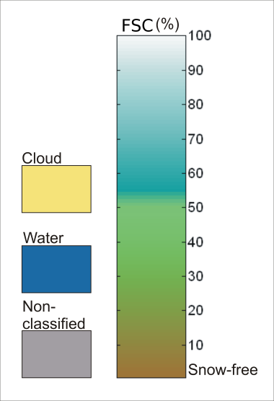
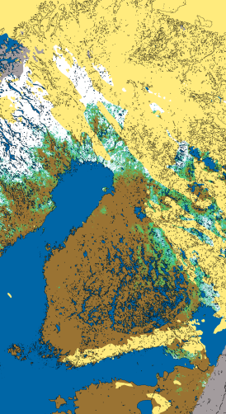
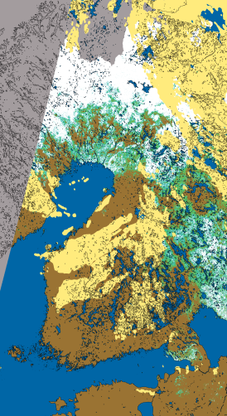
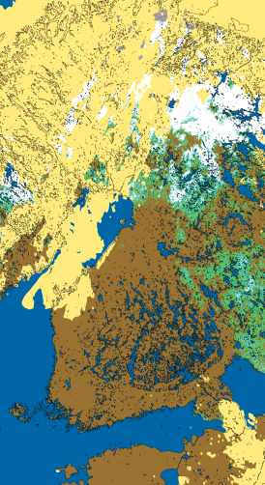
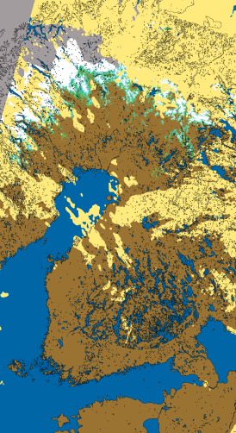
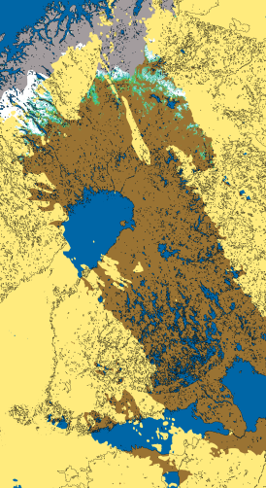
Snow Covered Area product for spring 2011
30.3.2011
10.4.2011
16.4.2011
17.4.2011
19.4.2011
23.4.2011
24.4.2011
25.4.2011
8.5.2011
13.5.2011

Slide 7
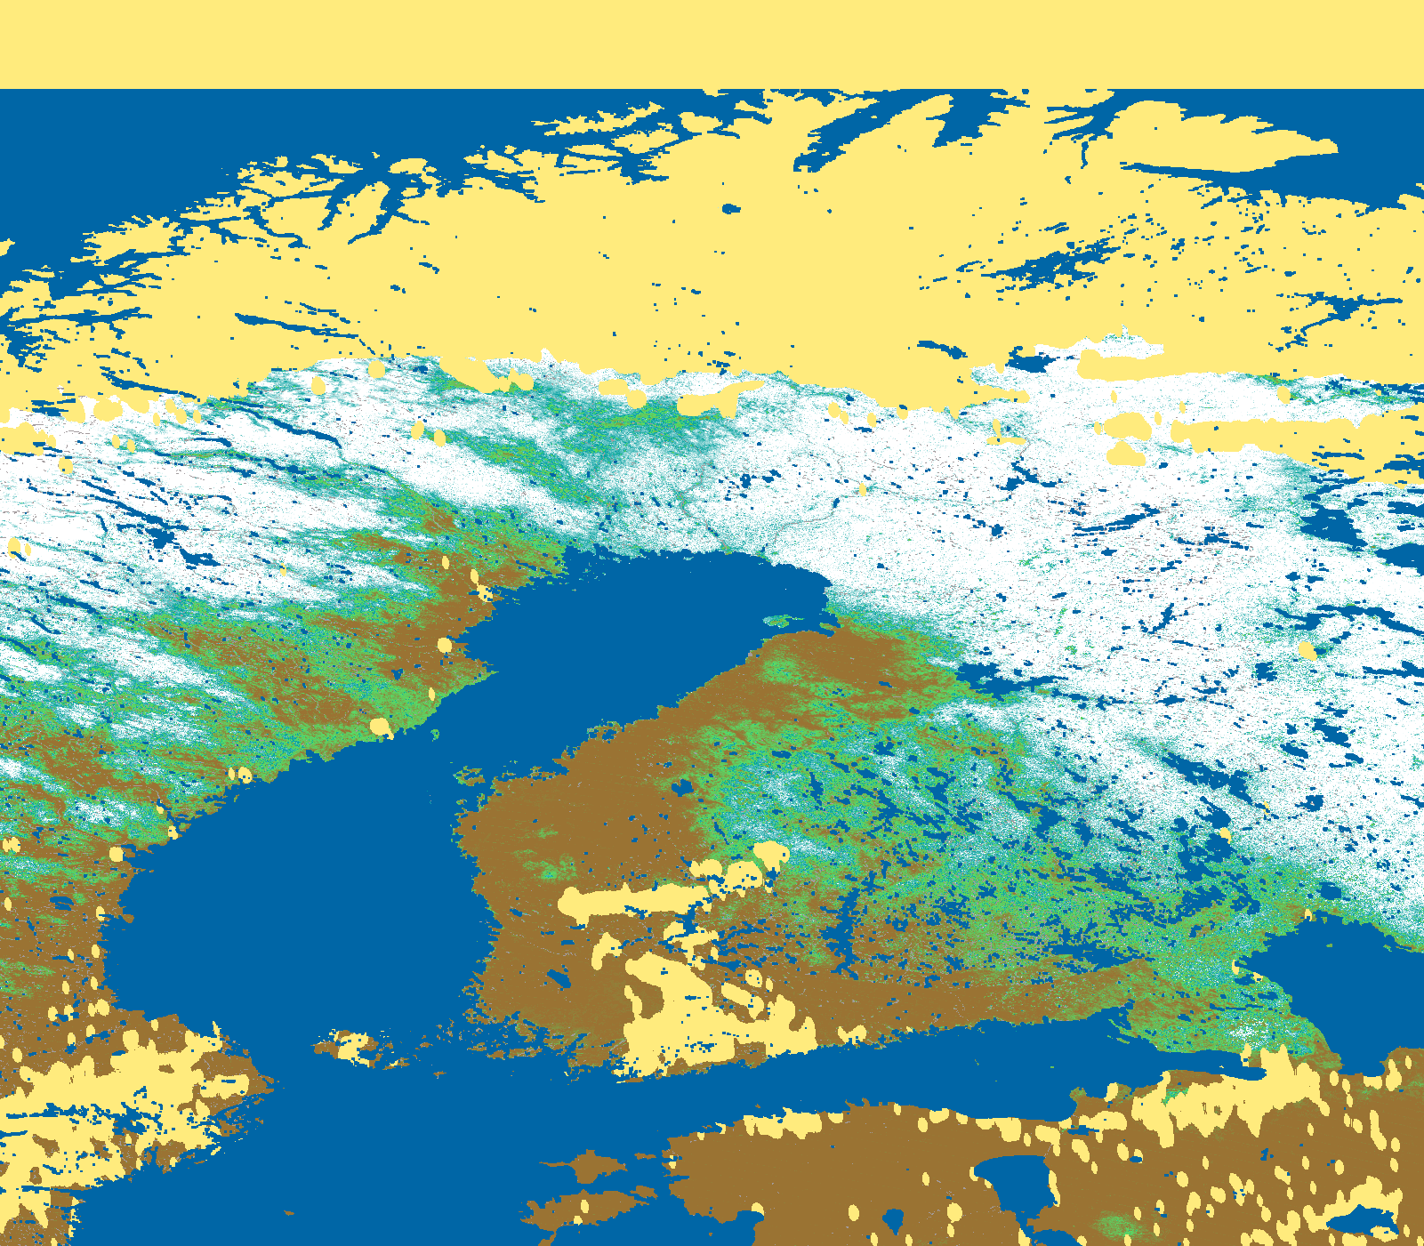
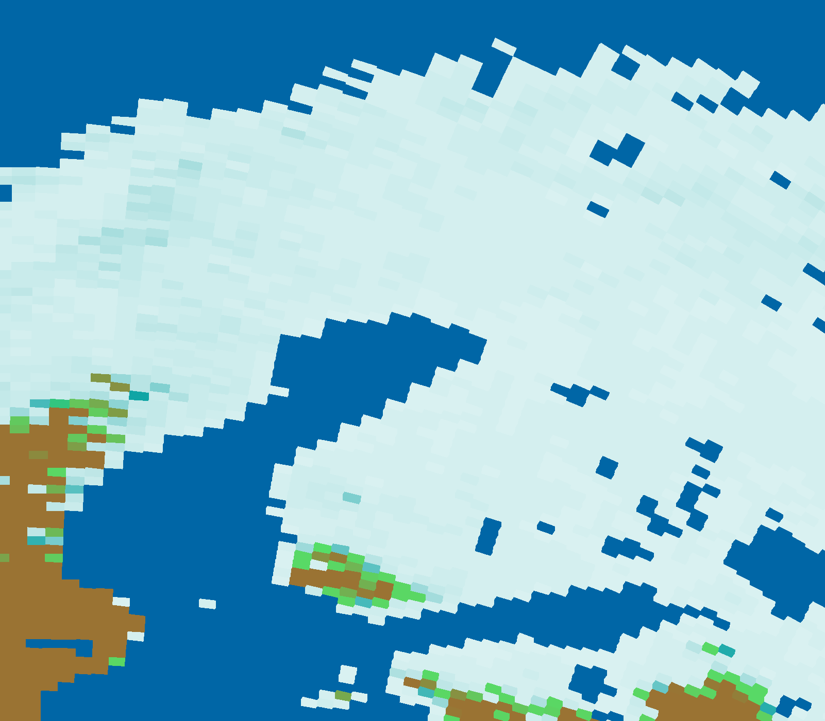

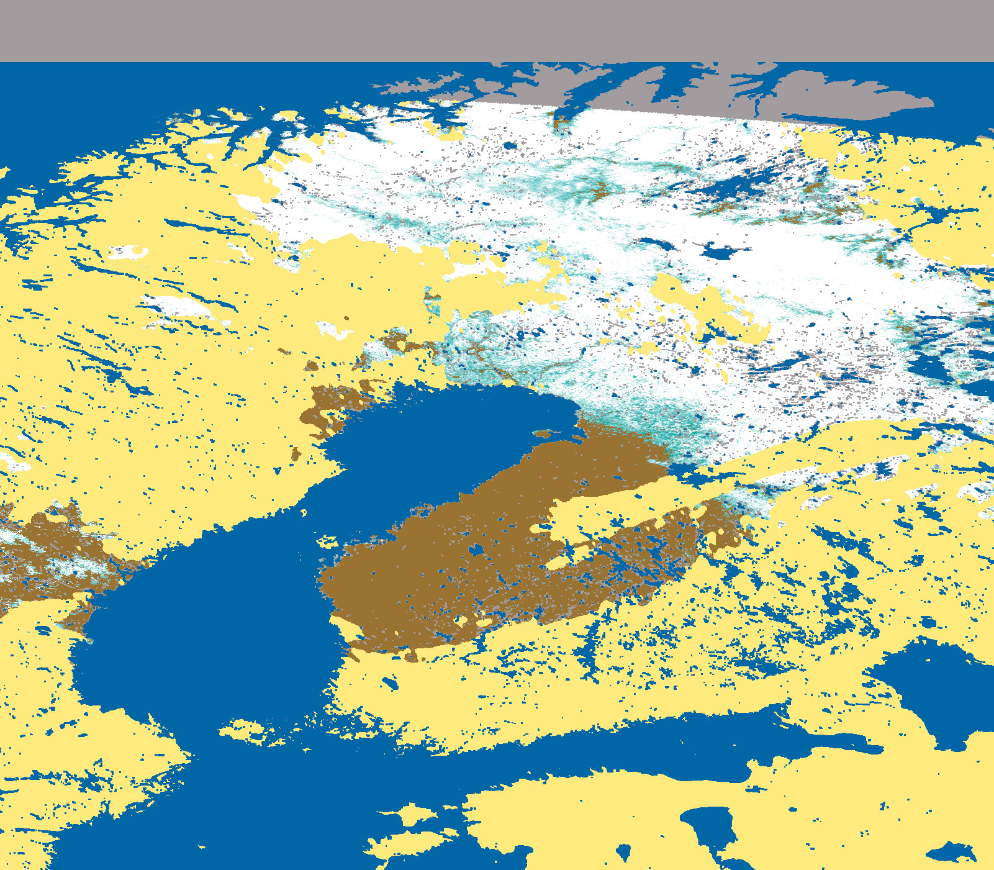
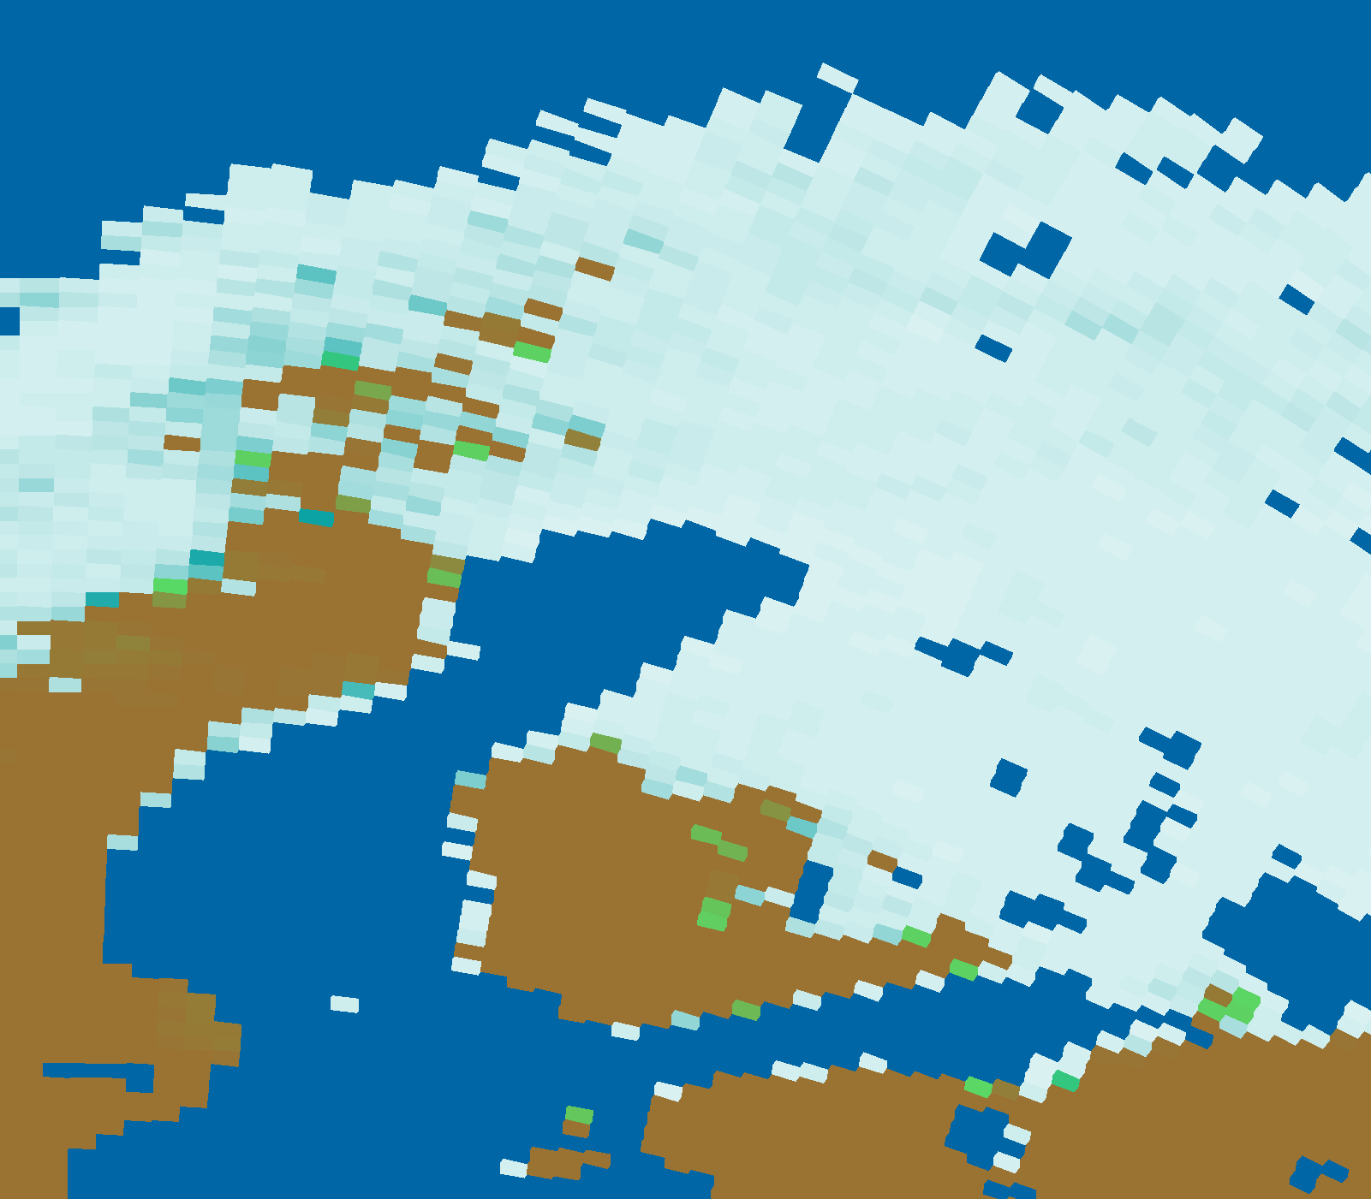
Comparison of model output and RS data
MODIS snow fraction
JSBACH snow fraction
April 21, 2003
May 04, 2003

Slide 8
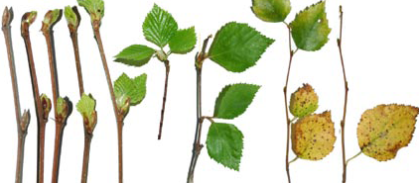
Extraction of start of season
Spring phenology influences terrestrial carbon balance (Richardson et al. 2010)
In broadleaf forest the start of growing season is linked to development of leafs
Photosynthetic recovery in evergreen coniferous forest occurs before canopy changes
Aim to develop satellite-derived start of season indicator calibrated to in situ observations at CO₂ flux measurement sites
budburst
Phenological stages of birch trees
Richardson et al.(2010). Influence of spring and autumn phenological transitions on forest ecosystem productivity. Philosophical Transactions of the Royal Society B: Biological Sciences, 365, 3227-3246

Slide 9
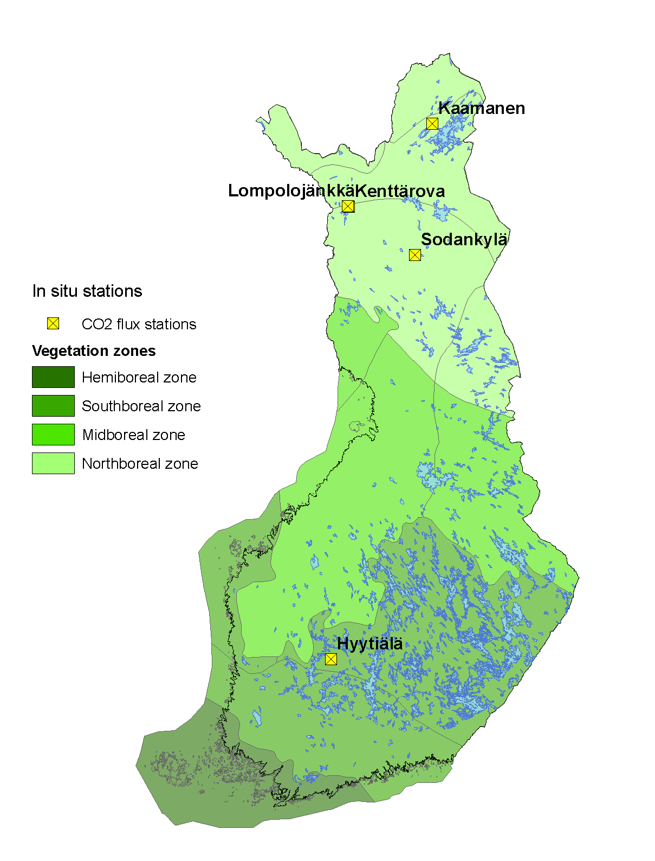
In situ observations
Reference dates for onset of growing season for coniferous forest and wetland sites determined from CO₂ flux measurements
A fixed fraction of peak growing season gross primary production (GPP) was used as a threshold value for the growing season onset

Slide 10
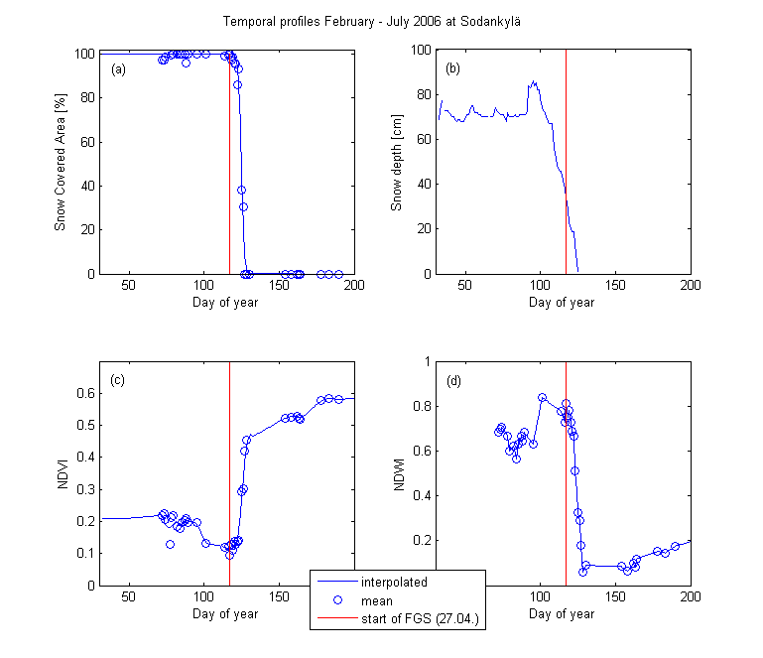
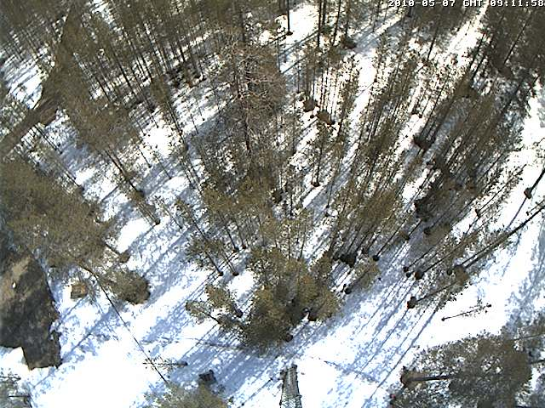
Sodankylä: Coniferous forest
Onset of growing season in coniferous forest coincides with decrease of fractional snow cover and beginning of spring-rise of NDVI
(a) Mean Snow Covered Area and interpolated profile;
(b) Snow depth measurement station Sodankylä;
(c) Mean NDVI and smoothed profile;
(d) Mean NDWI and linear interpolated profile.
Start of season 07.05.2010

Slide 11
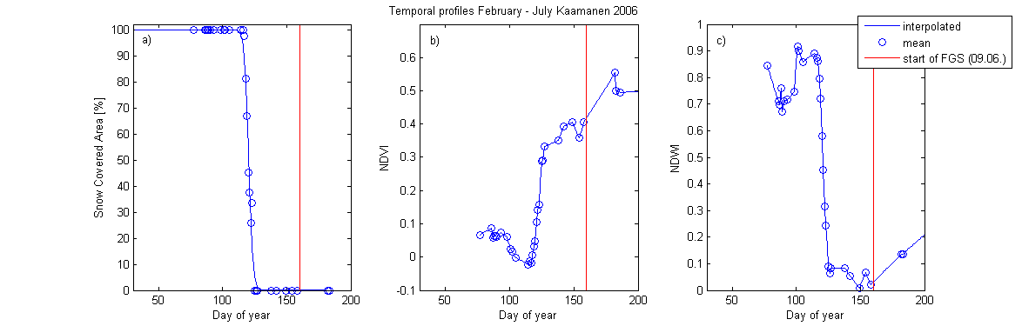
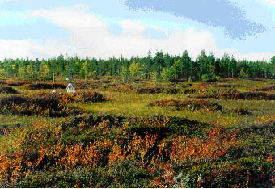
Kaamanen: Fen
NDWI minimum in spring corresponds to the vegetation state before greening-up
actual greening-up may lag end of snow melt for a certain period (Delbart et al. 2005)
http://www.fluxdata.org:8080/
SitePages/siteInfo.aspx?FI-Kaa
(a) Mean value Snow Covered Area and interpolated profile;
(b) Mean NDVI and interpolated profile;
(c) Mean NDWI and linear interpolated profile.
Delbart, N. et al., 2005. Determination of phenological dates in boreal regions using normalized difference water index. Remote Sensing of Environment 97, 26-38.

Slide 12
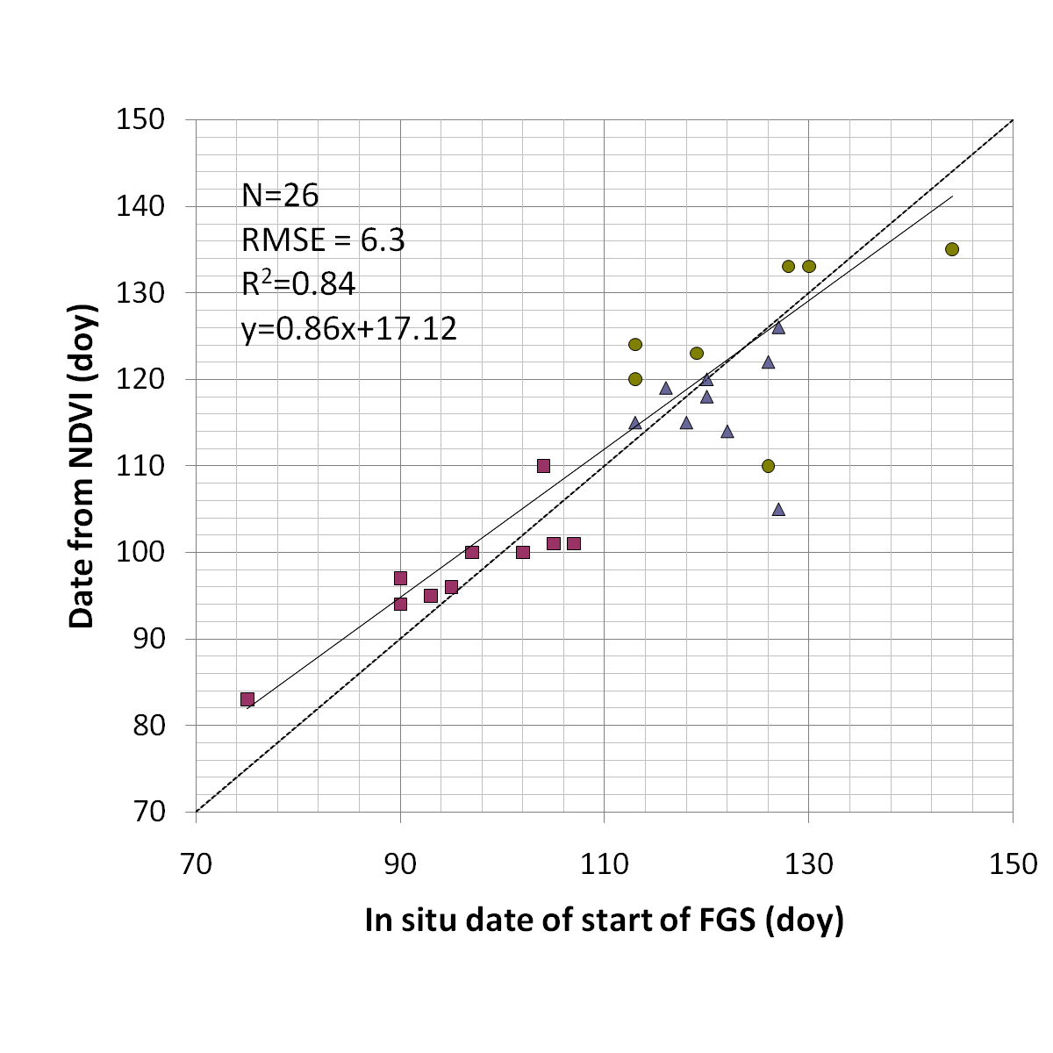
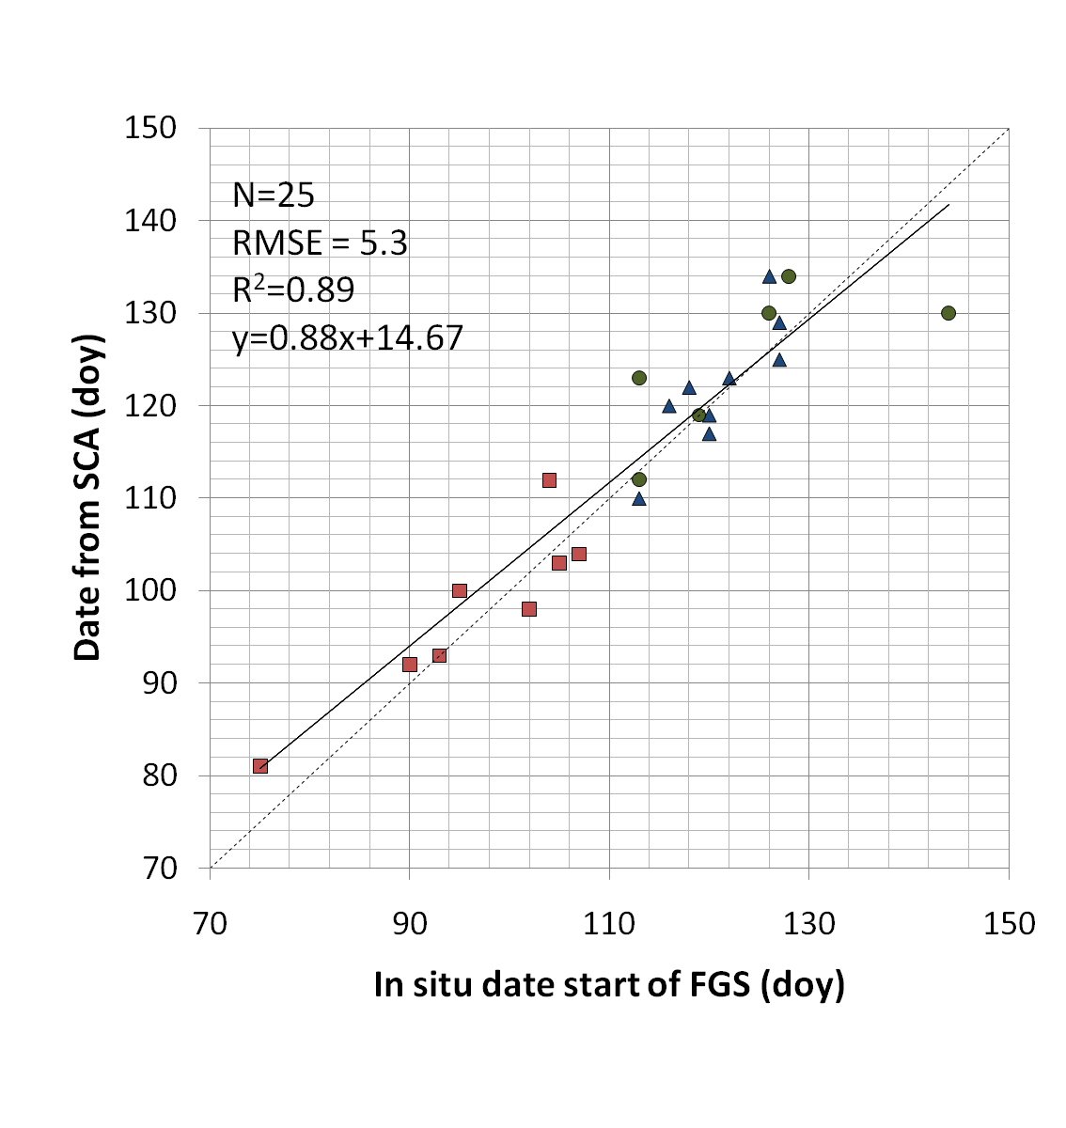
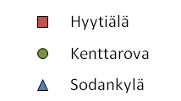
Satellite-derived start of season
    Comparison of satellite-derived start of growing season for evergreen coniferous sites with in situ dates
FGS: Flux Growing Season. Doy: day of year.

Slide 13
Maps of the start of growing season
    Extraction of start of season based on NDVI and NDWI time-series (Delbart et al. 2005) for pixels with dominance of coniferous forest and wetlands
    Aggregation of results for comparison with JSBACH land surface model-derived start of season
Delbart, N. et al., 2005. Determination of phenological dates in boreal regions using normalized difference water index. Remote Sensing of Environment 97, 26-38.

Slide 14
Summary
Harmonized MODIS time-series for describing the annual cycle of vegetation and the evolution of snow cover during the melting period for comparison with model output
Comparison of observed and modelled snow cover indicate delayed melting in the model
Proxy indicator for the start of season of evergreen coniferous trees from MODIS time-series
Different method needs to be applied for deciduous species

Slide 15
Outlook
Comparison of satellite-derived and modelled start of season
Length of season estimate from satellite time-series

